Slide 1





ShotBotTM
Formal Project Presentation
An MTE100/GENE121 Project
Group 445 - B. Seeton, N. Fernandes, A. Sahny, A. Dev Singh

Slide 2









The Design
Summary of the Design Problem

Slide 3
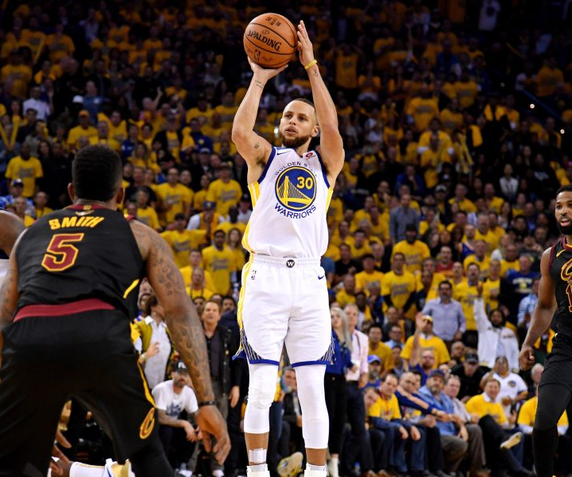
What is The Problem?
Shooting Practices are Boring.
Athletes Seek Competition.
“Practice Makes Perfect”
More Practice —> Better Results
Shooting Practice Made Fun :)
https://ftw.usatoday.com/2018/06/nba-finals-golden-state-warriors-steph-curry-masterclass-learn-how-to-shoot-videos

Slide 4
Requirements & Constraints
What are the Requirements and Constraints for the Design?

Slide 5
Requirements / Criteria
± 20% Accuracy
53.24 Centimeters
What are the Requirements for the Robot?
What is the Criteria for Success?
How Far Must the Robot Shoot?

Slide 6
Constraints / Restrictions
3 Kilograms
30 Minutes
What are the Constraints for the Robot?
How Heavy can the Robot Be?
How Long can the Robot Run For?

Slide 7
The Physical System
A Detailed Exhibition of the Mechatronics System

Slide 8


Features of the Project
Highlighting Key Components and Outlining All Important Features

Slide 9

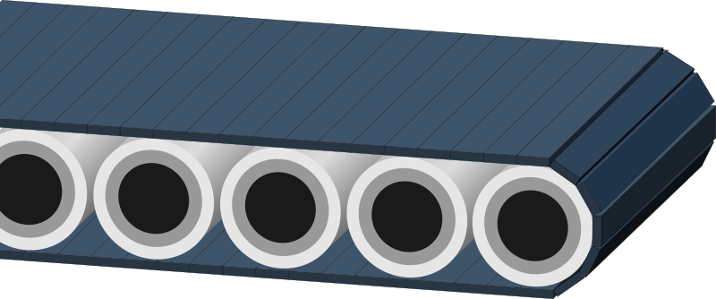
Conveyor Belt Mechanism
https://www.1001freedownloads.com/free-clipart/conveyor-belt-2

Slide 10

Ball Collection System
https://www.pinterest.ca/pin/619033911250784229/

Slide 11

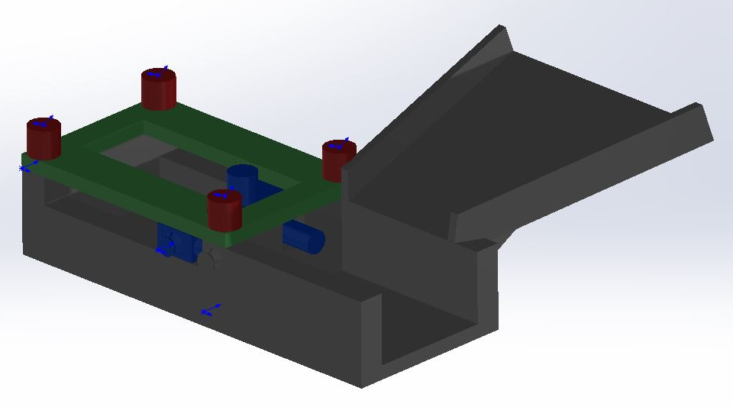
Shooting Mechanism

Slide 12

Data
Collection
https://www.smartdatacollective.com/empirically-proven-data-collection-tactics-for-web-administrators/

Slide 13

Decision Making Process
https://baystateherald.com/2019/09/16/artificial-intelligence-ai-robots-market-2019-trending-technology-global-size-insights-and-forecast-till-2026/

Slide 14
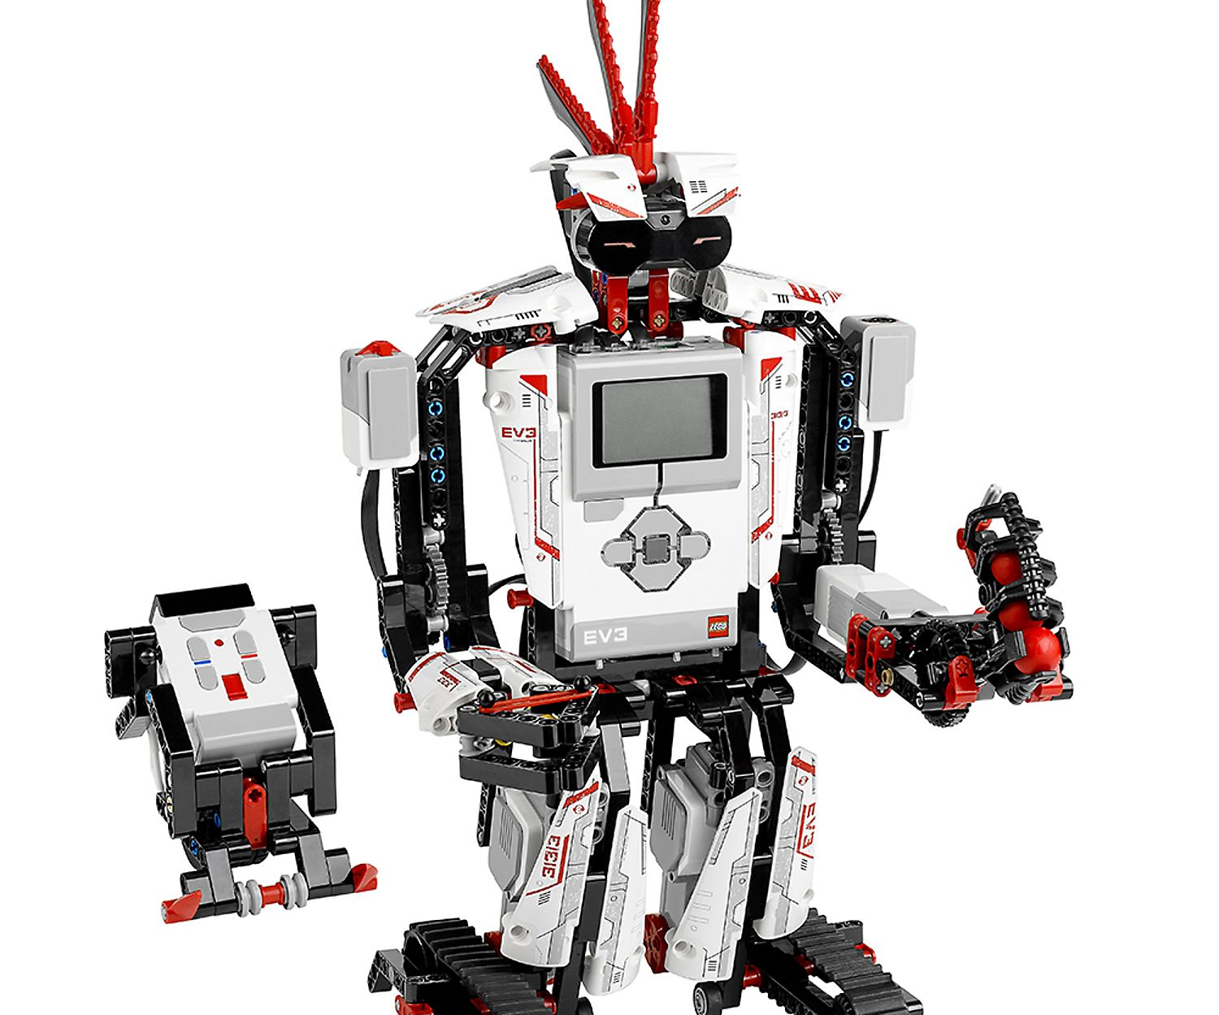
Motors & Sensors
MOTORS | SENSORS
Continuous (2) Movement in x and y Directions | Colour Amount of Points Awarded
Large EV3 Align Shooting Arm with Basket | Ultrasonic (2) Determine Position on Court
Medium EV3 Pull Elastic Back Before Release | Gyro Angle at Shooting Location
_________ | Touch Recording Shots Made
https://www.lego.com/en-us/product/lego-mindstorms-ev3-31313

Slide 15
Meeting the Constraints
How Does the System Meet the Constraints?

Slide 16
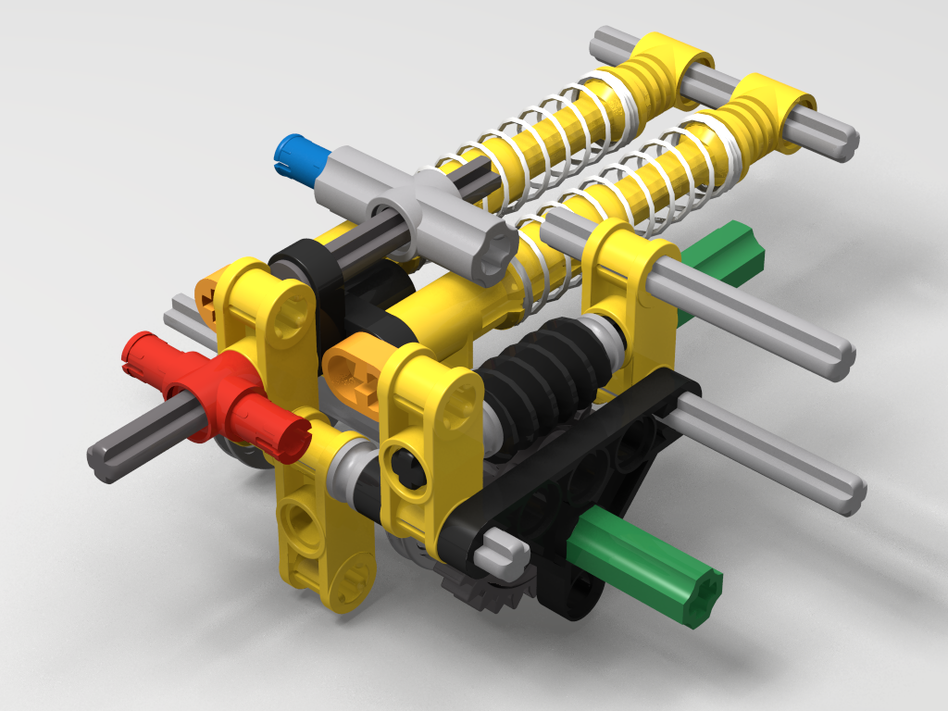
Changes Made Since Initial Plan
Court Dimensions
Shooting Mechanism Idea
Shooting Mechanism Design
Scoring Algorithm
Increase Competition
http://fantasygames.com.pl/shooting-mechanism-1/

Slide 17
The Demonstration
Start-Up Procedure
User Input - Time
Saved Coordinates
Start @ Collection Point
1
Regular Operation
Constantly Shooting
Ball Collection
Recording Data
2
Shut-Down Procedure
Timer End
Display Statistics
Wait for Button Press
3

Slide 18
What Could
Go Wrong?
Potential Sources of Error and Test Cases

Slide 19
Running Tests Before Demo Day
Evaluating the System Before Demo Day

Slide 20
What does Success Look Like?
Criteria for Success and How to Measure it

Slide 21
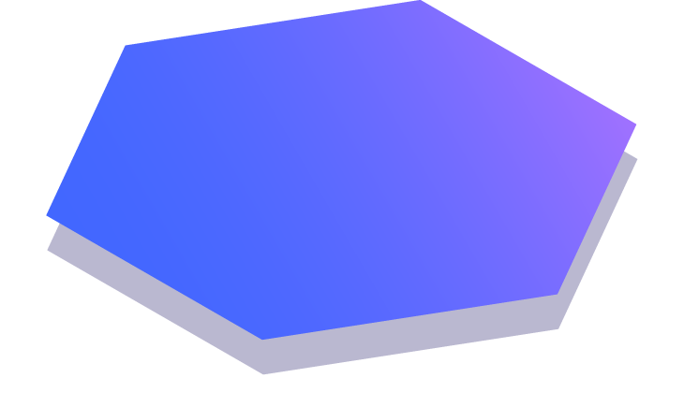
Thanks!
Any Questions or Feedback?

